Slide 1
Science Unit
Plants
Science is knowledge about the natural world that is based on facts that are learnt through experiments and investigations.

Slide 2
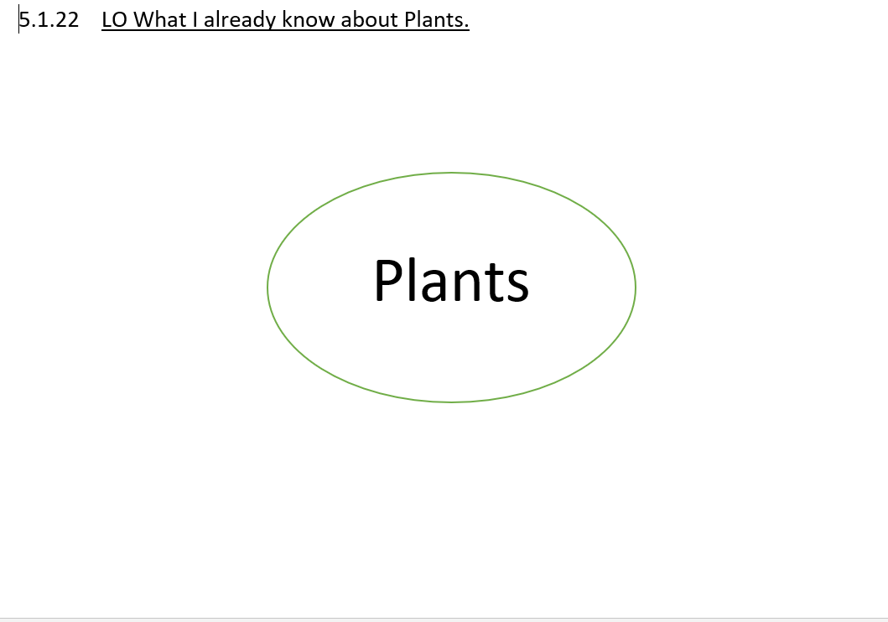

Slide 3
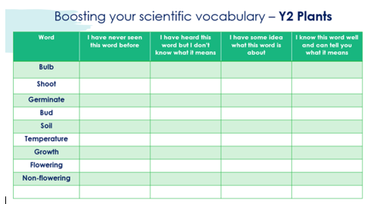

Slide 4
A request from Mrs Hargreaves

Slide 5
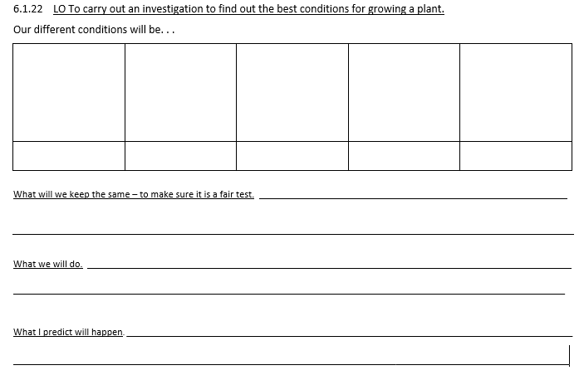
How could we find the best possible conditions to grow a plant?

Slide 6
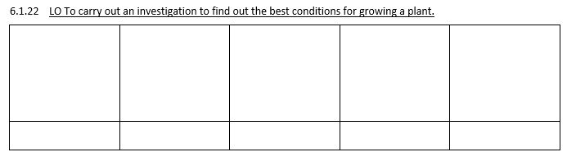

Slide 7
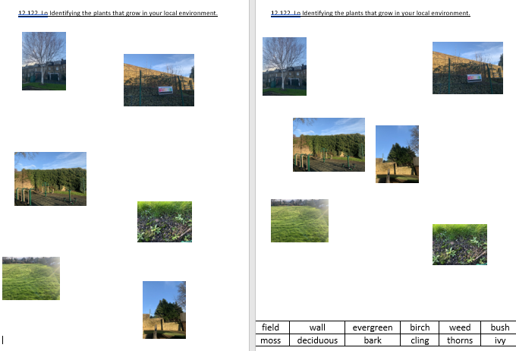
Identifying the plants that grow in your local environment.

Slide 8
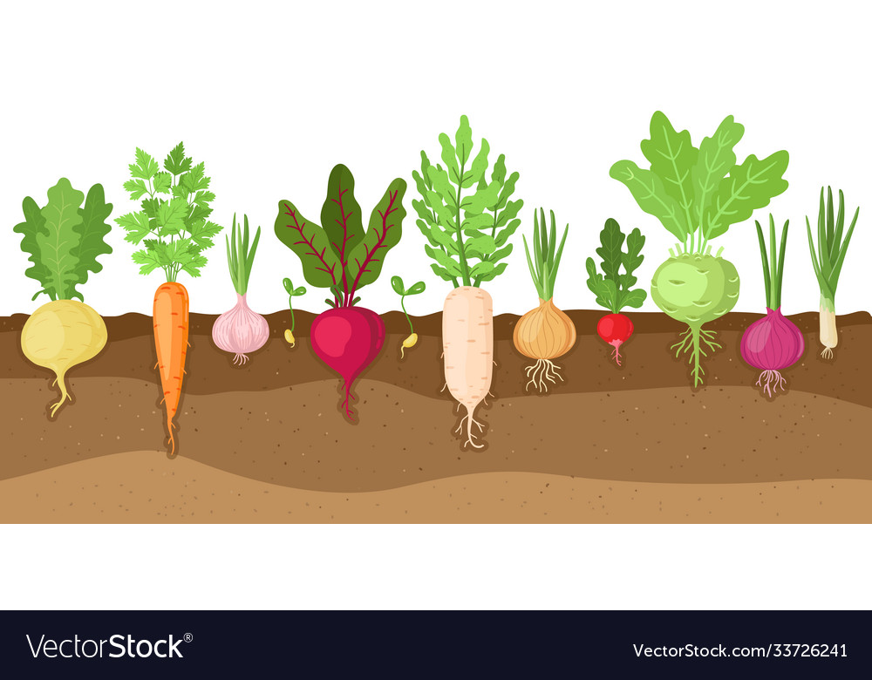
26.1.22 LO Knowing the plants we eat.

Slide 9
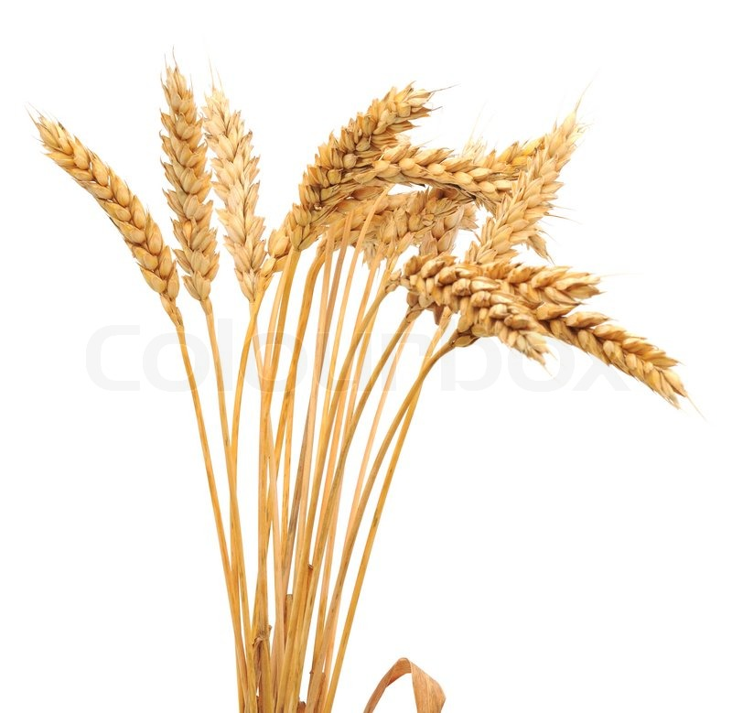
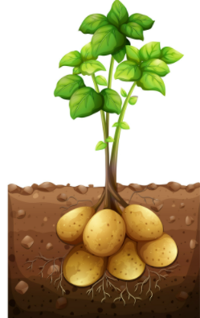
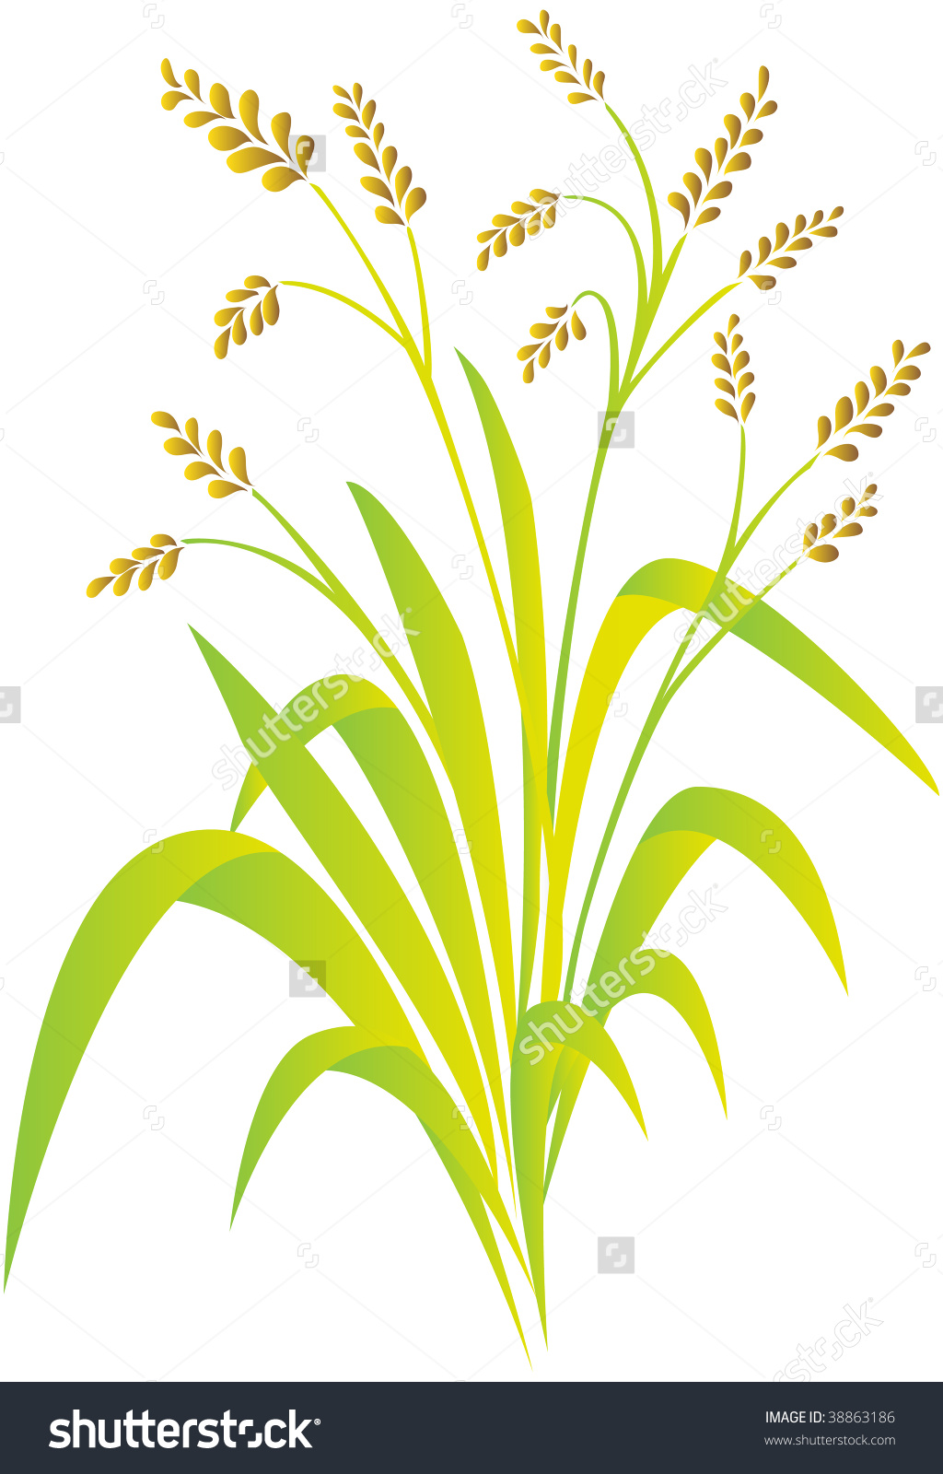
LO Knowing the plants that we eat.

Slide 10
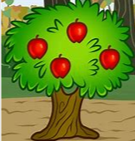
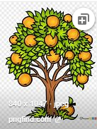
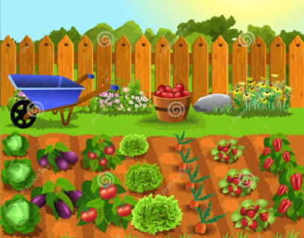
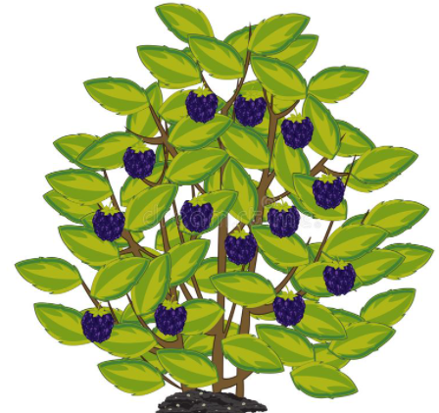
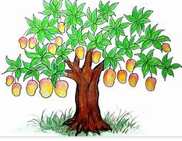














26.1.22 LO Knowing the plants we eat.

Slide 11
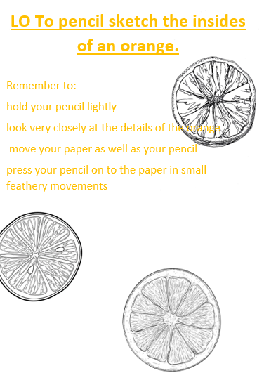
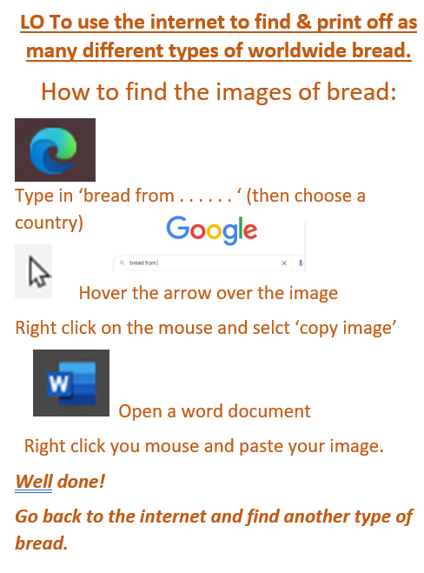
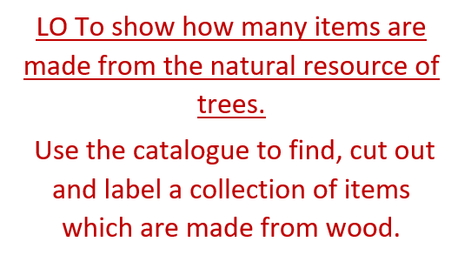
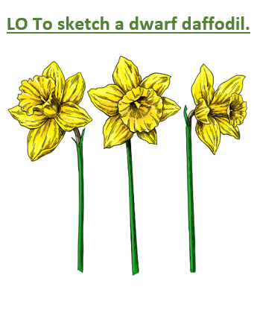
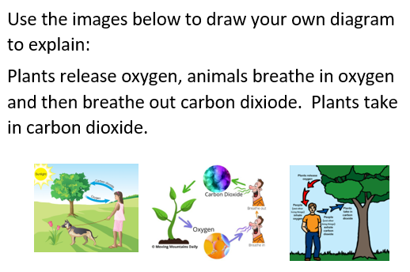
How do plants help us?

Slide 13
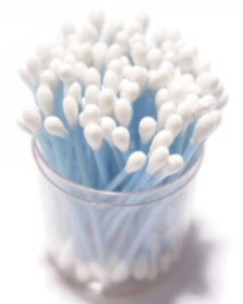
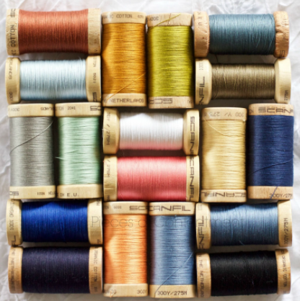
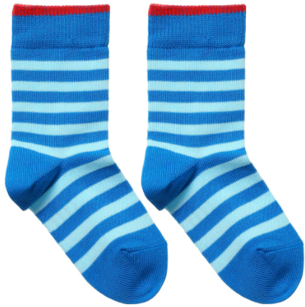

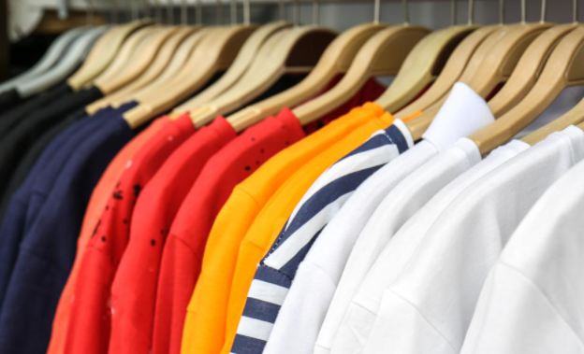
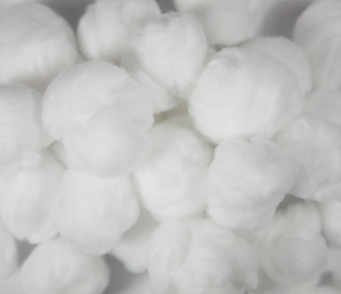
Have you ever wondered where cotton comes from?
https://www.bing.com/videos/search?q=cotton+for+children&&view=detail&mid=8AEBEDD3677639F69C8B8AEBEDD3677639F69C8B&&FORM=VRDGAR&ru=%2Fvideos%2Fsearch%3Fq%3Dcotton%2520for%2520children%26qs%3Dn%26form%3DQBVDMH%26%3D%2525eManage%2520Your%2520Search%2520History%2525E%26sp%3D-1%26pq%3Dcotton%2520for%2520children%26sc%3D3-19%26sk%3D%26cvid%3D135B292FFA5C480891CCDD57DF53486B

Slide 14
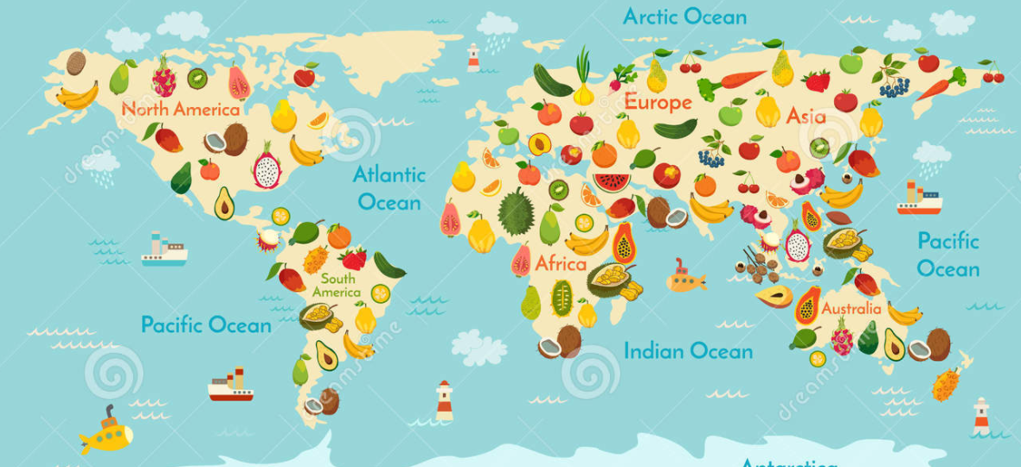
Different foods grow in different places; depending on the climate.

Slide 15

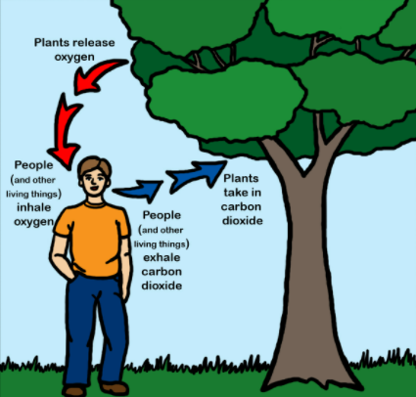
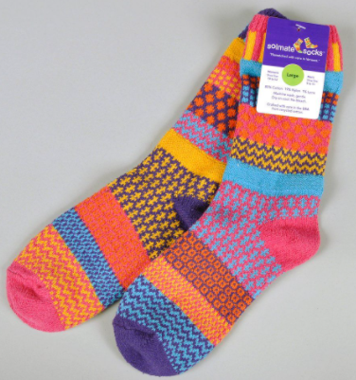
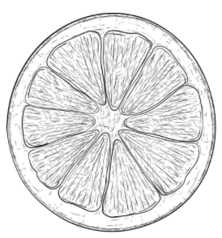
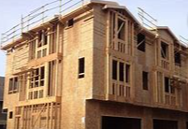


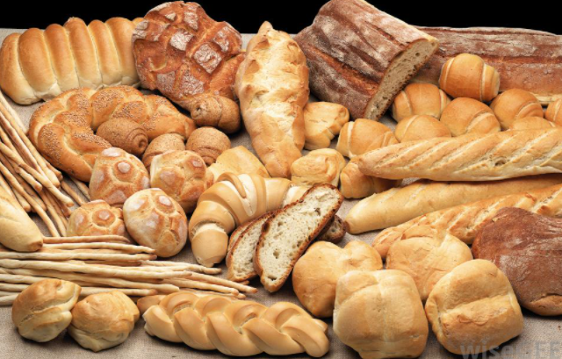
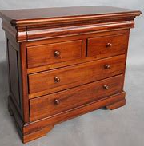
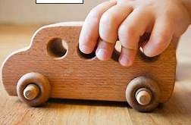
We need to show the rest of school the importance of plants.
LO To display the many benefits of Plants.
What is your favourite . . .

Slide 16
Display groups:
1. Observational drawings of oranges
2. Map of world food
3. Explanation of oxygen / carbon dioxide
4. Brightly painted of flowers
5. Print off images of different types of bread
6. Catalogue of wooden items

Slide 17
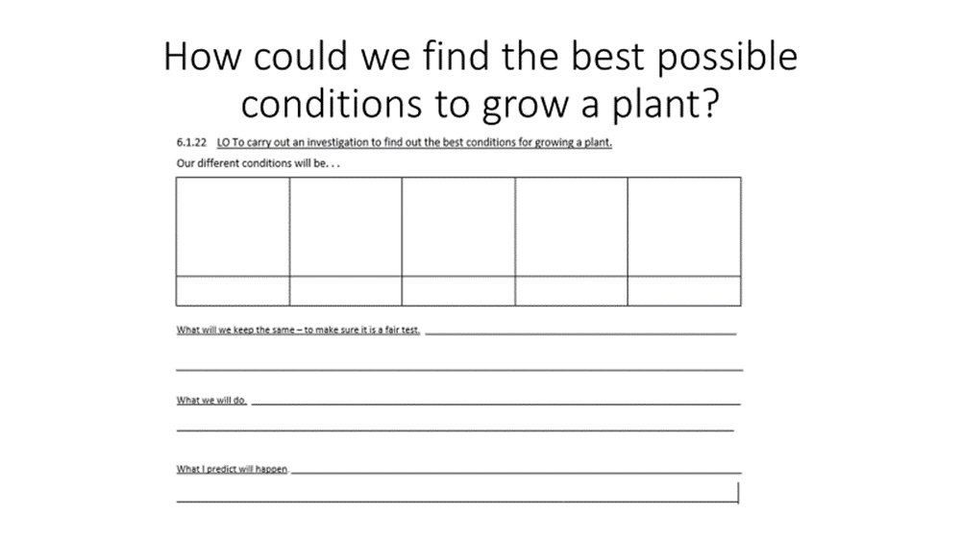
Do you remember when we started our investigation?
What does a healthy plant look like?

Slide 18
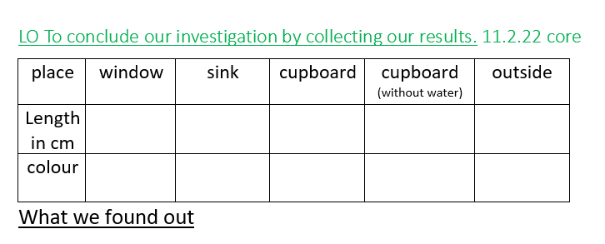
































LO To conclude our investigation by collecting our results.

