Slide 1
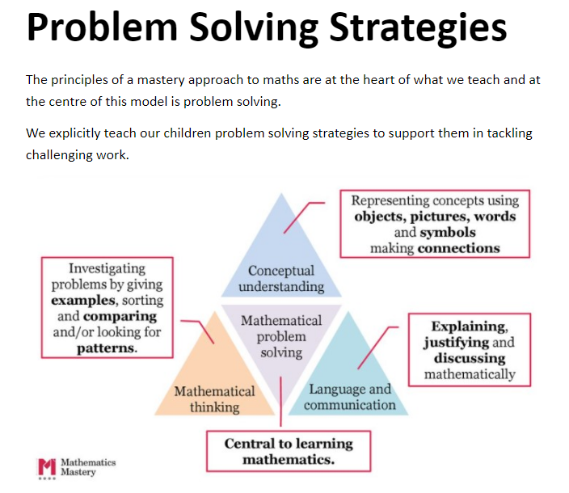
Problem Solving Strategies at St Philip’s
We aim to provide children who are stuck with a problem to either use their understanding of number or use one of these strategies to ‘unlock’ the problem to enable them to be successful.
Trial and improvement - elimination incorrect solutions systematically.
Act it out - use resources or act out the problem.
Draw it – draw the problem.
Create a table or list to organize the numbers or facts in a systematic way.
Simplify the problem by making it more accessible or understandable.
Spot a pattern – this may be extended to reveal a solution.
Working backwards.
Use Algebra.

Slide 2


Trial and improvement
Draw it

Slide 3



Work backwards
Spot a pattern

Slide 4



Make a list
Act it out

Slide 5
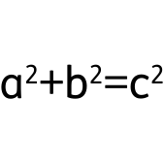
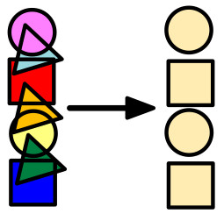
Use Algebra
Simplify

