Slide 1
COLLECTIVE WORSHIP
Joy and Spirituality – what do we think they are?

Slide 2
Our school prayer
We thank you God for this amazing, beautiful world,
For the unique people you have created us to be,
Our loving families and the friends in our lives,
And for our health and the food we eat.
We pray that we can be kind and respectful,
To have the courage to make the right choices,
And to learn from our mistakes,
We pray that we can work together with hope in our hearts.
Amen

Slide 3
How do joy and spirituality connect together?
Discussion

Slide 4
Feedback…

Slide 5
Spirituality makes a person more open to positive emotions and feelings.
Share examples…
How do joy and spirituality connect together?

Slide 6
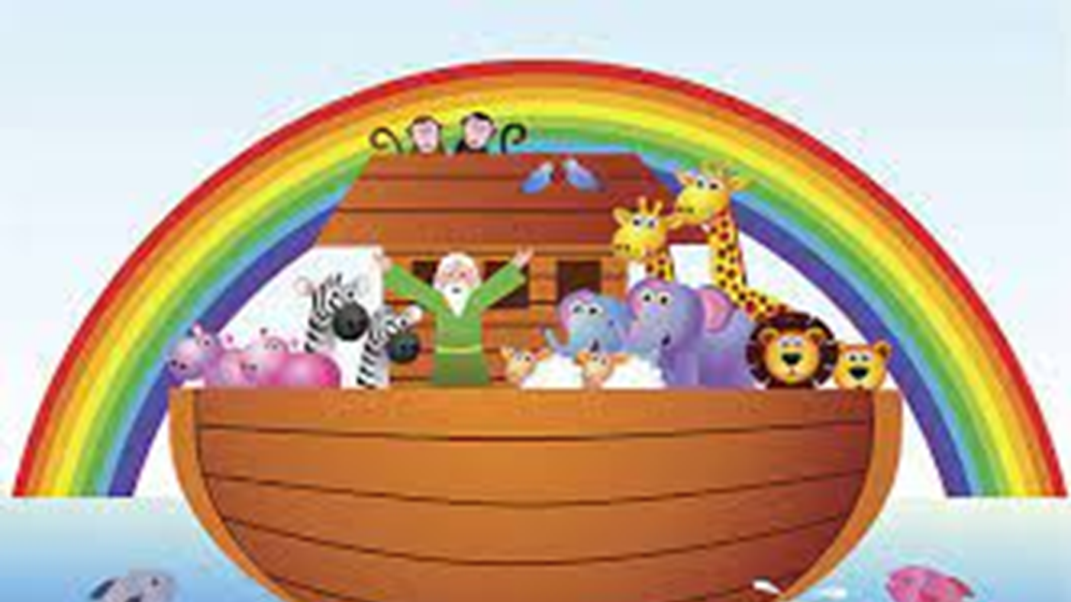
HOW DOES THIS LINK TO OUR VALUES HERE AT ST PHILIP’S?

Slide 7
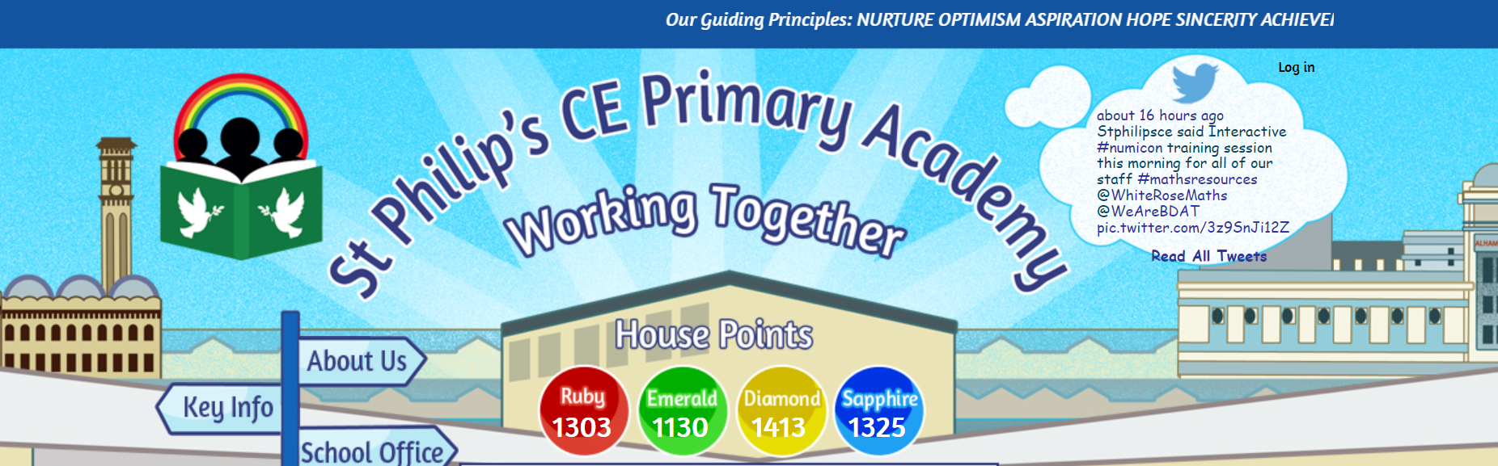
Working together with hope in our hearts
Nurture
Optimism
Aspiration
Hope
Sincerity
Achievement
Respect
Confidence

Slide 8
PRAYER
Dear God,
We thank you for giving us spirituality and helping us to connect with you and others.
We thank you for bringing joy into the many blessings you have included in our lives.
We pray that you will give us joy from now until forever.
Amen.

Slide 9


