Slide 1
COLLECTIVE WORSHIP
Joy and Spirituality – what do we think they are?

Slide 2
Our school prayer
We thank you God for this amazing, beautiful world,
For the unique people you have created us to be,
Our loving families and the friends in our lives,
And for our health and the food we eat.
We pray that we can be kind and respectful,
To have the courage to make the right choices,
And to learn from our mistakes,
We pray that we can work together with hope in our hearts.
Amen

Slide 4
Discussion

Slide 5
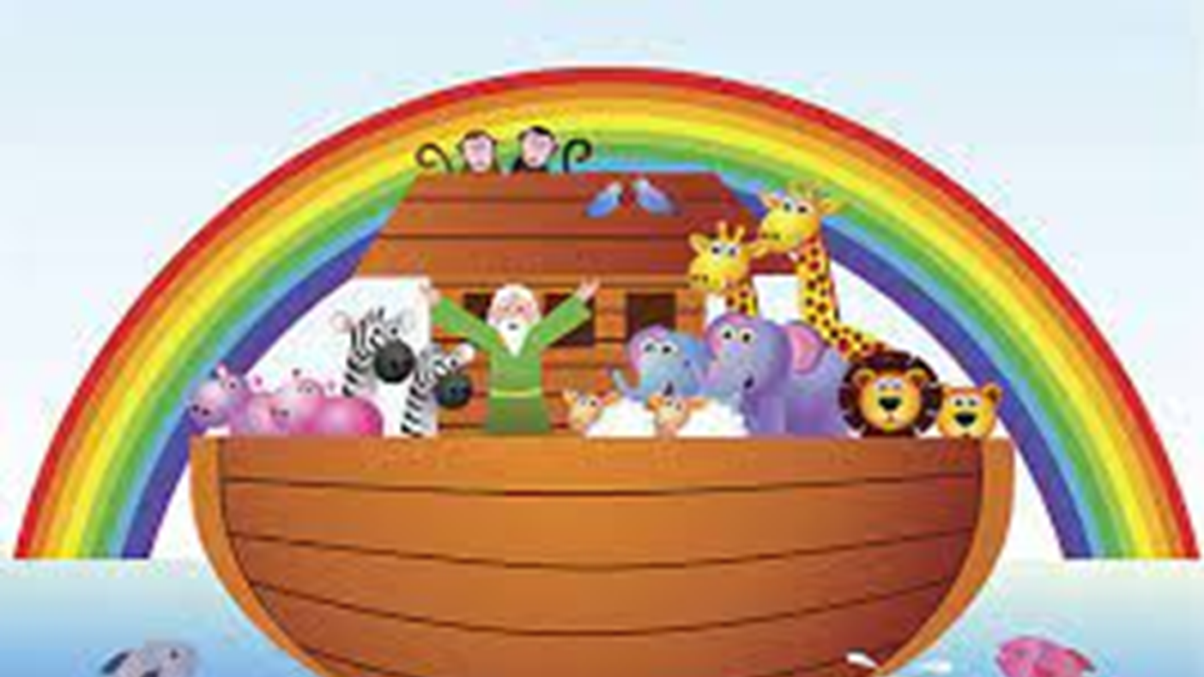
HOW DOES THIS LINK TO OUR VALUES HERE AT ST PHILIP’S?

Slide 6
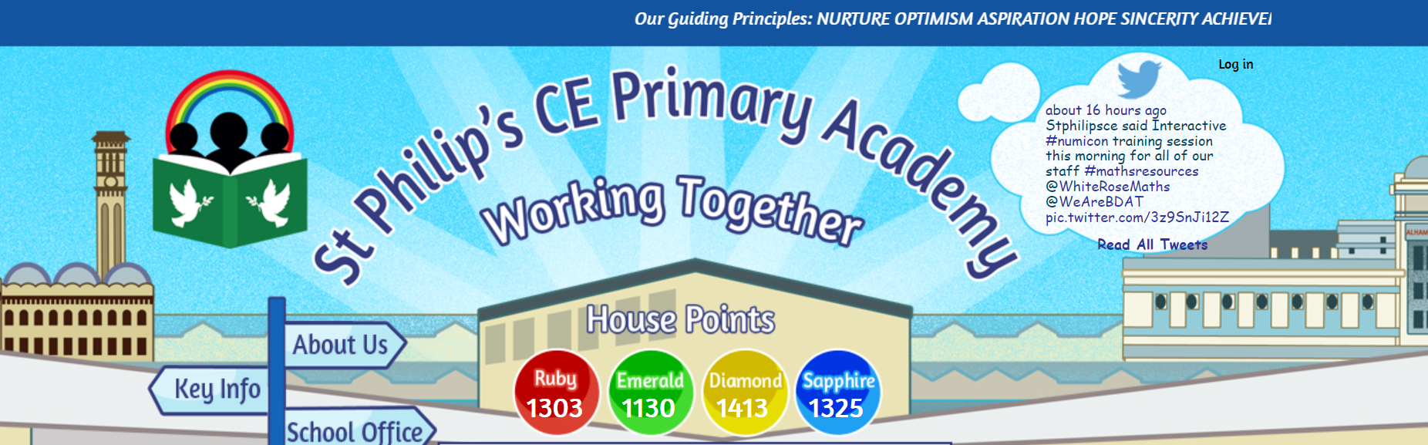
Working together with hope in our hearts
Nurture
Optimism
Aspiration
Hope
Sincerity
Achievement
Respect
Confidence

Slide 7
PRAYER

Slide 8


