Slide 1
COLLECTIVE WORSHIP
Eating Healthily

Slide 2
Our school prayer
We thank you God for this amazing, beautiful world,
For the unique people you have created us to be,
Our loving families and the friends in our lives,
And for our health and the food we eat.
We pray that we can be kind and respectful,
To have the courage to make the right choices,
And to learn from our mistakes,
We pray that we can work together with hope in our hearts.
Amen

Slide 3
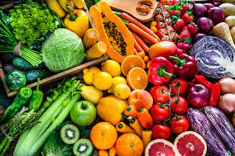
https://www.youtube.com/watch?v=mMHVEFWNLMc

Slide 4
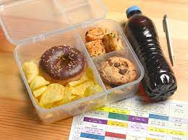
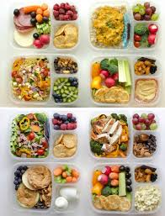
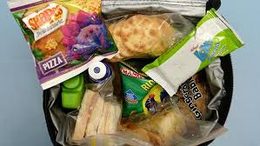
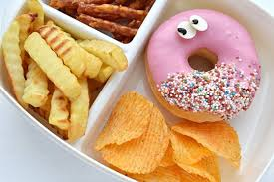
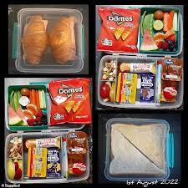

Slide 5

What we would like you to do…

Slide 6

HOW DOES THIS LINK TO OUR VALUES HERE AT ST PHILIP’S?

Slide 7
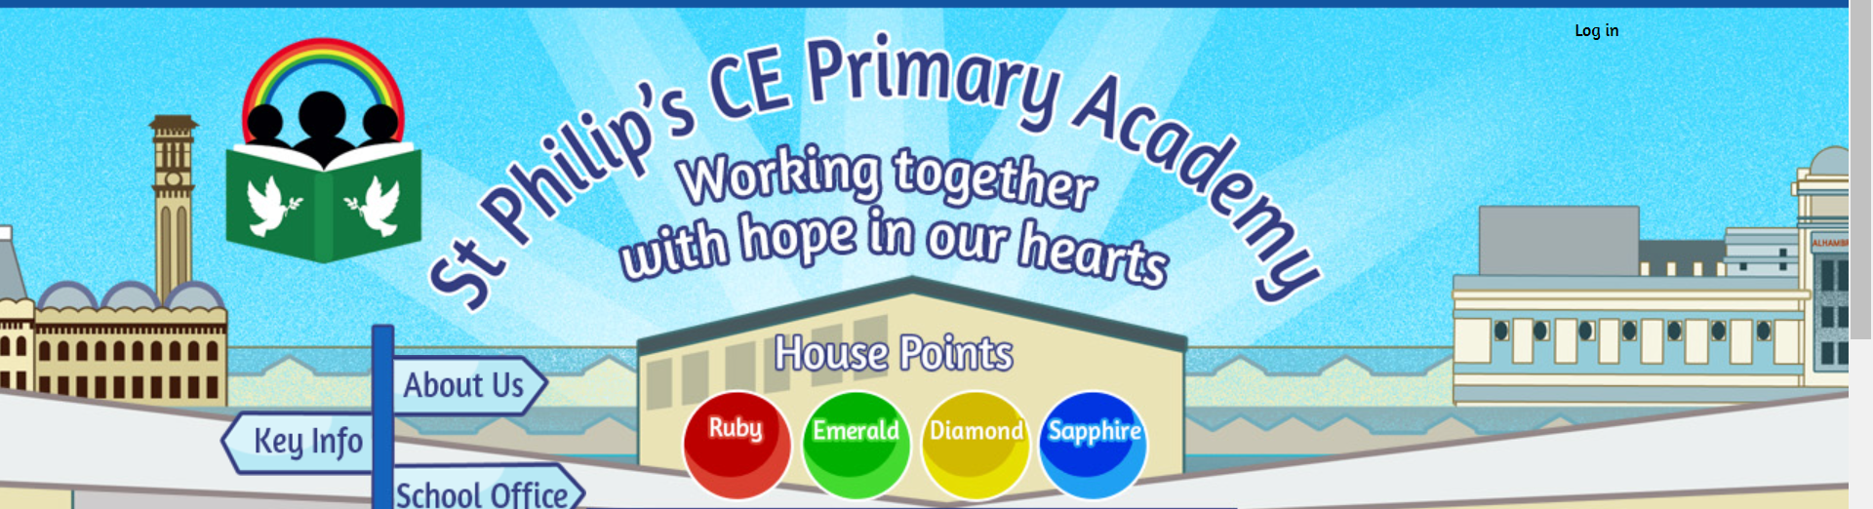
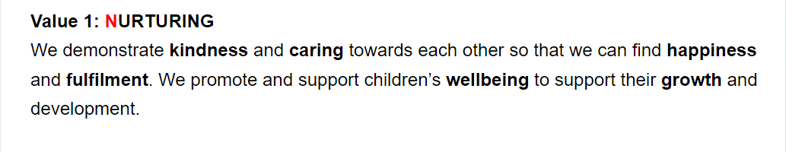

Slide 8
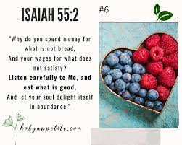

Slide 9
فَكُلُوا۟ مِمَّا رَزَقَكُمُ ٱللَّهُ حَلَـٰلًۭا طَيِّبًۭا وَٱشْكُرُوا۟ نِعْمَتَ ٱللَّهِ إِن كُنتُمْ إِيَّاهُ تَعْبُدُونَ ١١٤
So eat from the good, lawful things which Allah has provided for you, and be grateful for Allah’s favours, if you ˹truly˺ worship Him ˹alone˺.

Slide 10

PRAYER
Dear God,
Thank you for the food you provide us with.
Help us to stay healthy and to make the right choices.
Amen

Slide 11


